Slide 1
AP Statistics Chapter 4 Review
Regression and Residuals

Slide 2
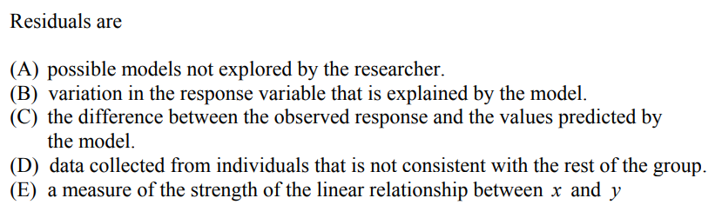

Slide 3
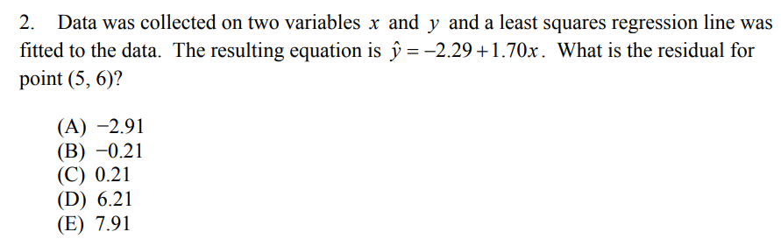

Slide 4
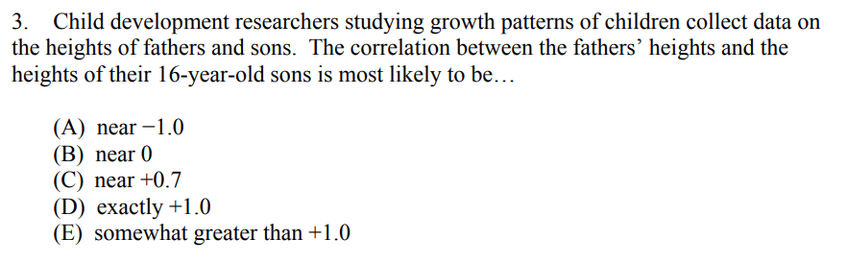

Slide 5
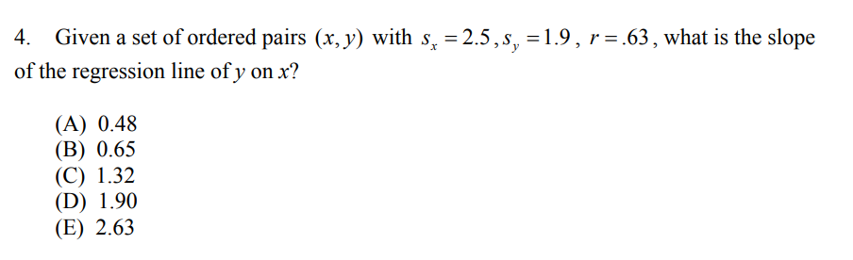

Slide 6
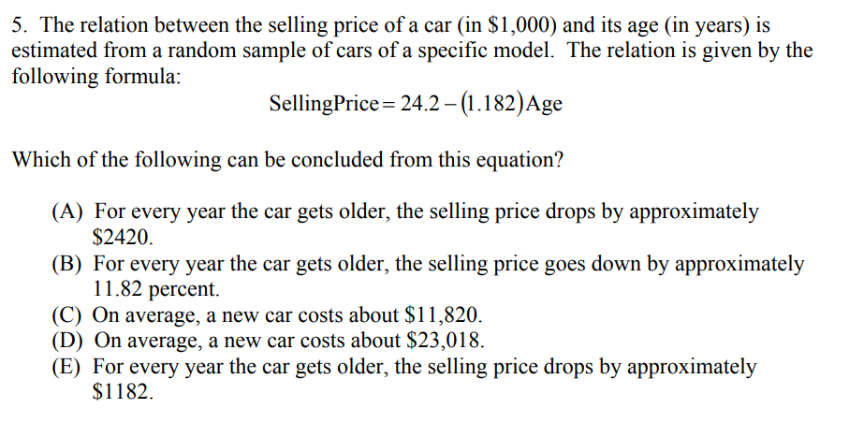

Slide 7
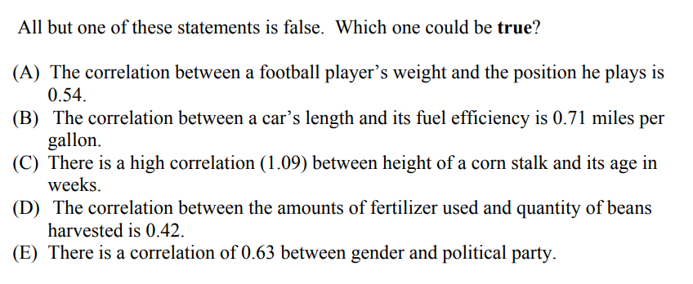

Slide 8
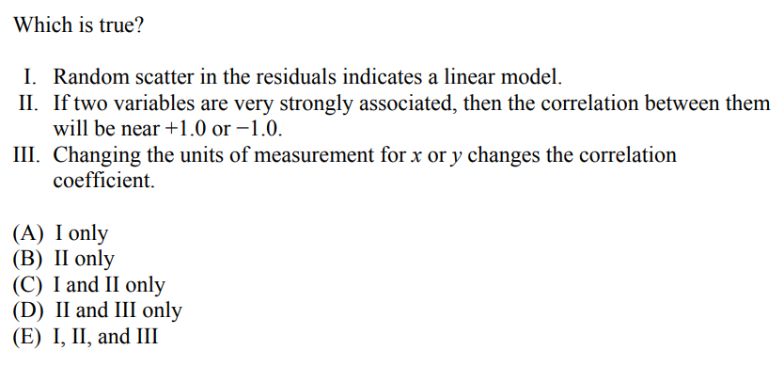

Slide 9
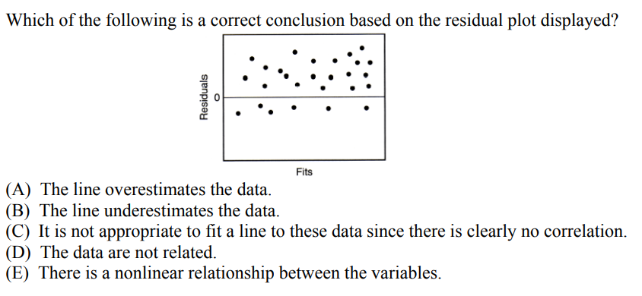

Slide 10
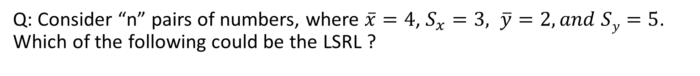
Q: Consider “n” pairs of numbers, where $\overline{x}=4$, $S_{x}=3, \overline{y}=2, and Sy=5$. Which of the following could be the LSRL ?

Slide 11
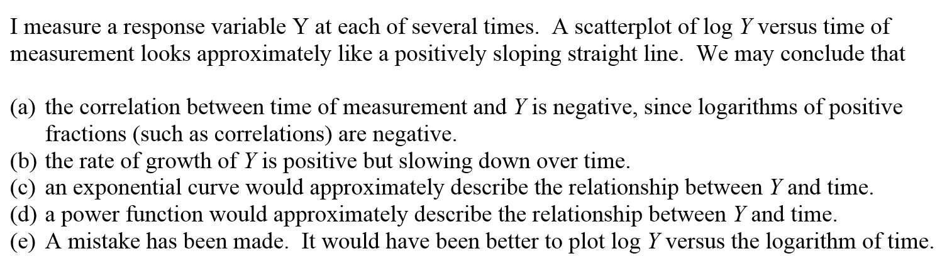
Answer: “C”
If log Y and time forms a linear relationship, then

Slide 12
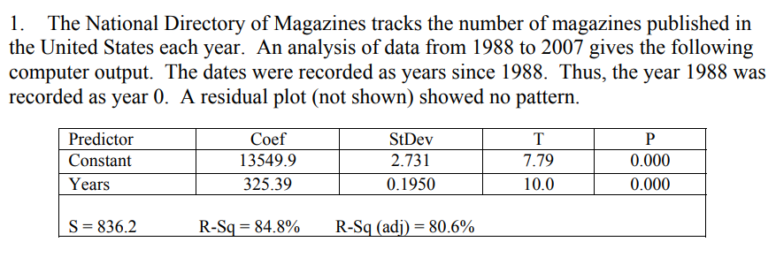
Response Variable: Number of magazines published in the US each year Explanatory Var: Years since 1988?
a) What is the Explanatory and Response variable?
b) What is the equation of the regression model?
c) Interpret the slope of the LSRL
d) Interpret the Y-intercept of the LSRL
e) What is the value of the correlation coefficient? Interpret this correlation in the context of the question:

Slide 13
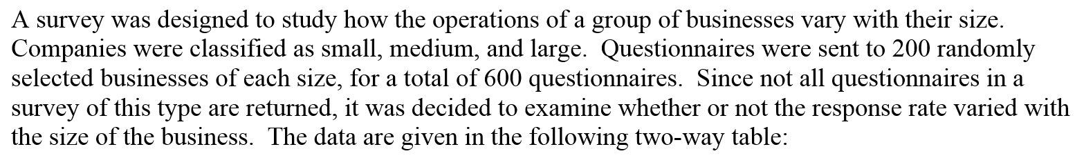
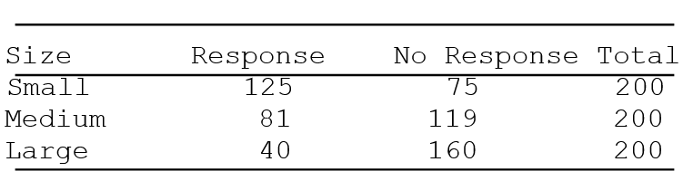
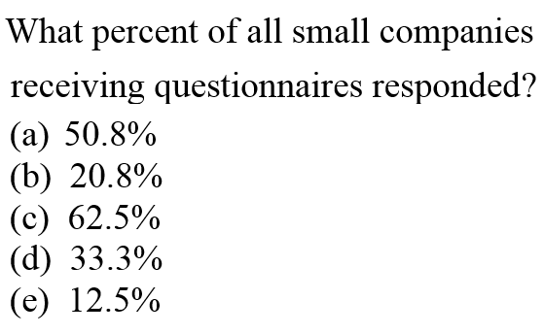
In total, 200 small companies responded. Out of 200, 125 responded
Percentage = 125/200
=5/8
=0.625
Answer “C”

Slide 14
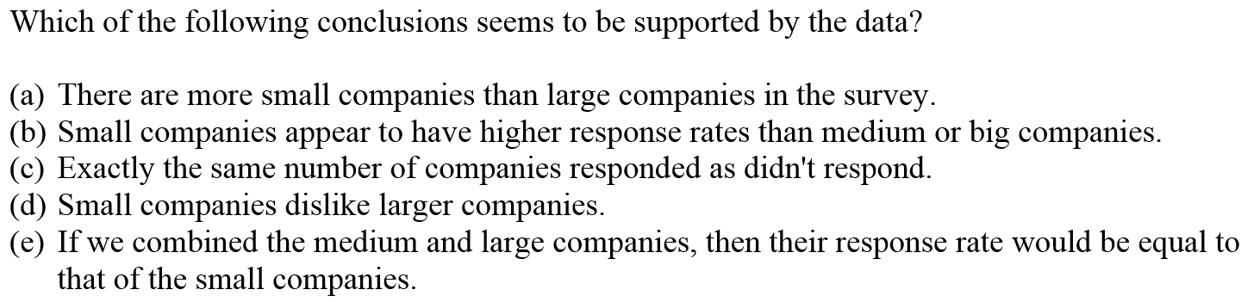
Answer: “B”

Slide 15
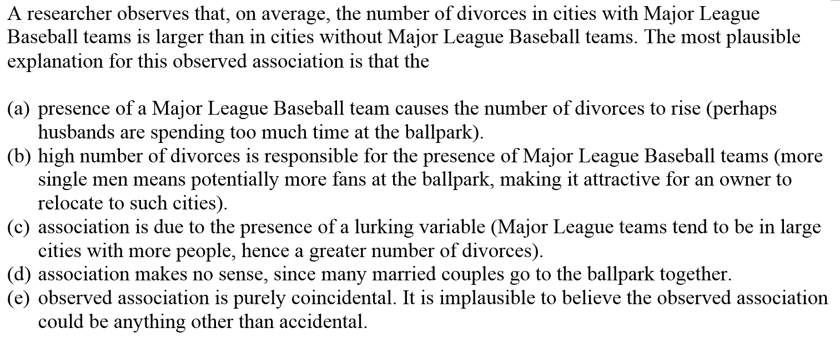
Answer: “C”, lurking variable is city population. A larger city population would likely increase the chances of both variables: having a Major League baseball team and number of divorcees

Slide 16
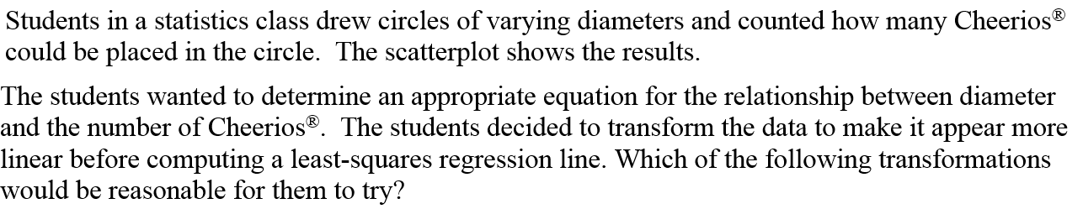
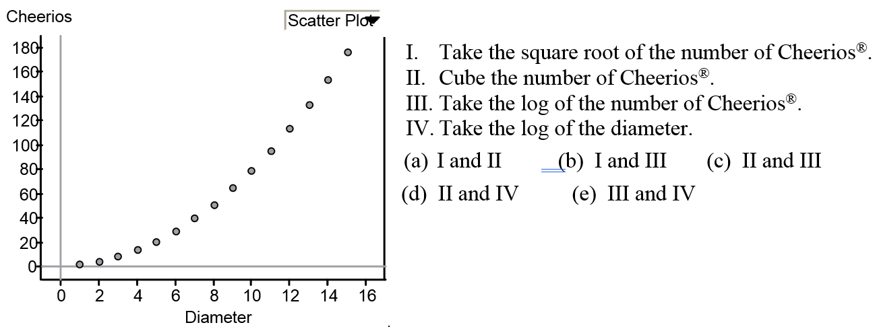
Answer “B”.
I) “Square root” works b/c the equation of a circle is A=πr².
iii) Taking the log of “y” would be reasonable to try, but to get a linear eq, b/c the exponent of “r” would be moved to the front of “r’.

Slide 17
Answer “A”, Slope is change in “Y’ over change in “x’.

Slide 18
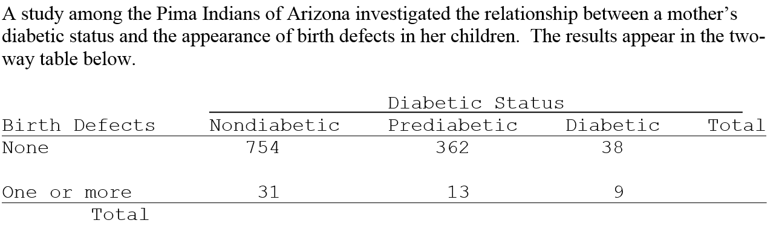
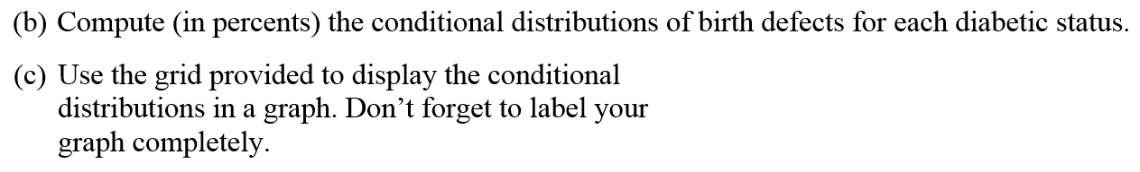

Slide 19

b) What is the marginal distribution of for each Diabetic status?
Non Diabetic:
Pre Diabetic:
Diabetic:
None: One or mOre
None: One or mOre
None: One or mOre
754/785
31/785
362/375
13/375
38/47
9/47
3.5%
81%
19%
96%
4%
96.5%

Slide 20
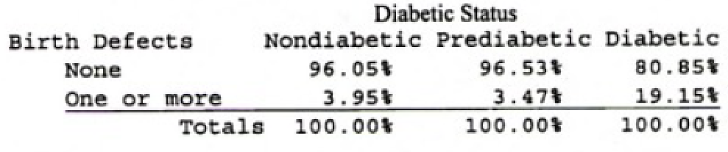
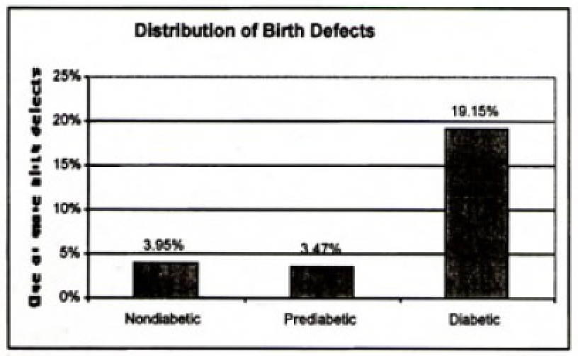

Slide 21
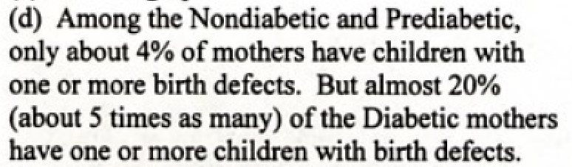

Slide 22
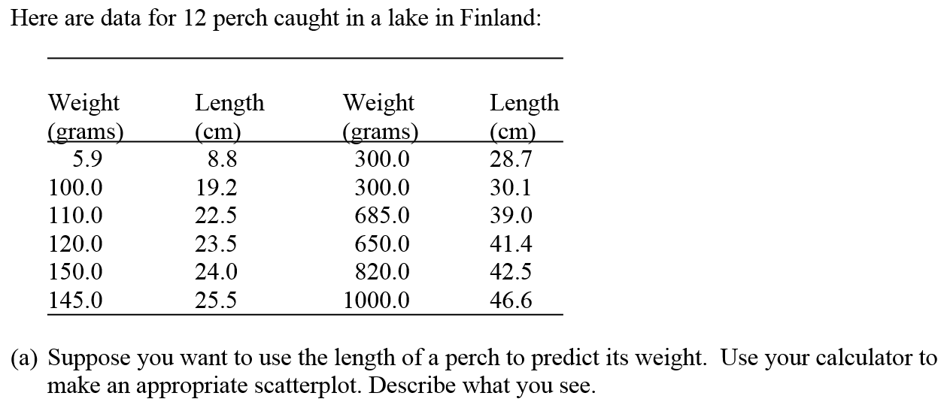
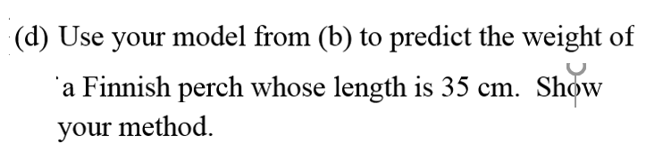
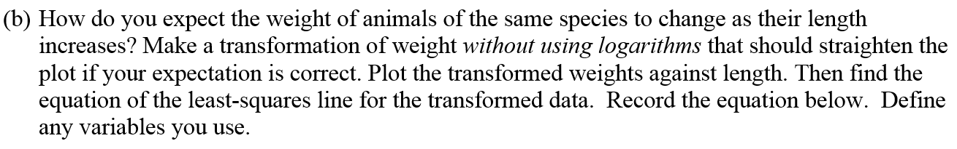

Slide 23
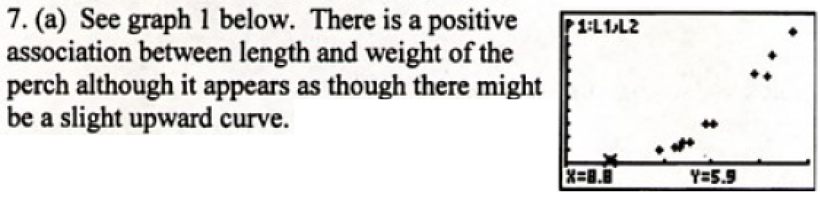

Slide 24
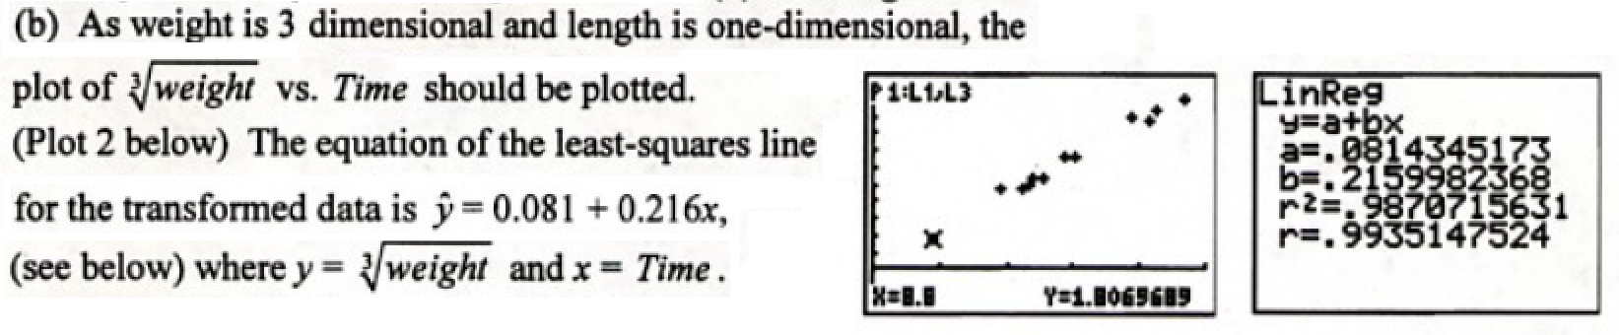

Slide 25
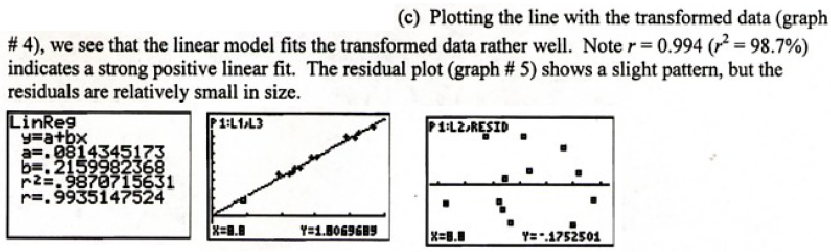

Slide 26
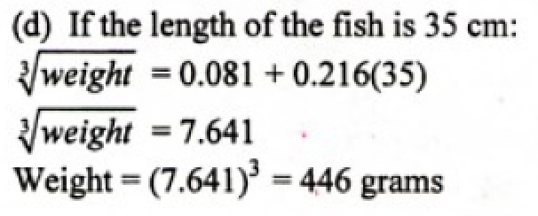

Slide 27
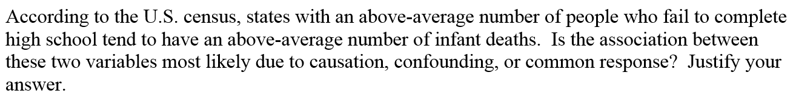

Slide 28
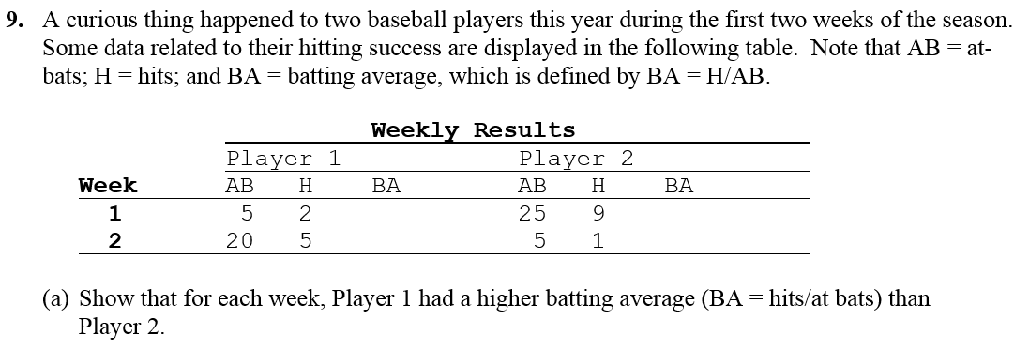

Slide 29
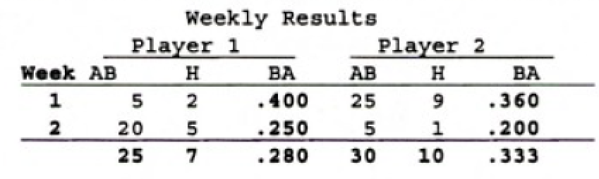
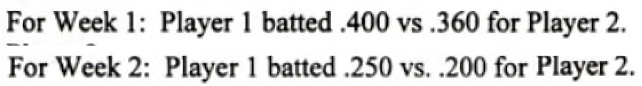

Slide 30
